Slide 1
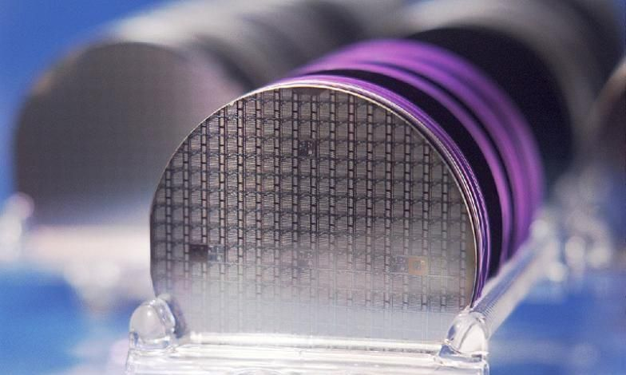
Wafer Defect Classifier
Naga Chandrasekaran, Daniel Chow, Lea Cleary, Scott Gatzemeier, and Erik Zinn

Slide 2
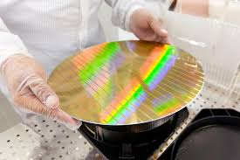
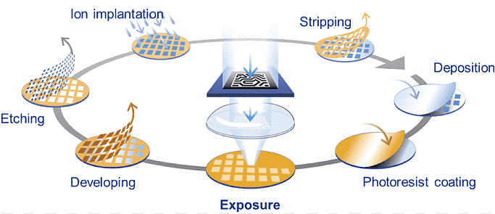
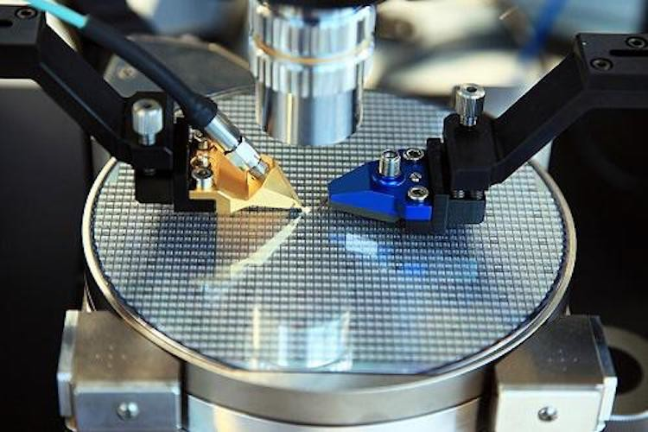
Chip manufacturing is complex
Several opportunities for a defect to occur
> 1000
Processing steps to finish a chip
> 10
Weeks of processing time
Start
End
> 100s
Equipment used in manufacturing
> 40000
wafers started every week

Slide 3
Yield maximization is critical for cost reduction
Defects are the primary factor impacting the number of good working chips on a wafer
91% yield
120 dies, 109 good
58% yield
26 dies, 15 good
Good Die
Defective Die
Defects = Yield = $ Cost

Slide 4

Wafer defect analysis is mainly performed manually by expert engineers
Challenges
Time-consuming
Varying expertise
Strict IP policies
Notes:
Challenges (first two from Intel paper):
Limited human-hour resources prevent engineers from reviewing and documenting every issue in every wafer in every lot
Detection accuracy depends on an engineer’s experience level. It takes many years for yield analysis engineers to gain experience in manufacturing process technologies to perform GFA (gross failure areas) detection accurately. This task tends to be a balance between art and science; engineers need many years of experience to learn how to distinguish accurately between random statistical “noise” and real GFAs/patterns/signatures.
Manufacturers are hesitant to share data, which results in limited data available for developing AI models.

Slide 5

Problem Statement
Automated Wafer Defect Classifier
Use a neural network to identify wafers with single defect patterns and classify them into different defect groups with >90% accuracy

Slide 6

Where does our data come from?
WM-811K is the largest open source dataset from real production process
Wafer Bin Map
Defective Wafer
Probing
Fabrication
Assembly
Final
Test
Blank Wafer
Fabricated Die
Die bank
Package
End Product
Front End Operations
Back End Operations
Notes:
Main points:
Using WM-811K dataset, largest open source dataset from real production process
Data = pass/fail wafer bin maps from electrical probing after manufacturing
Can be treated as a grayscale image classification problem

Slide 7
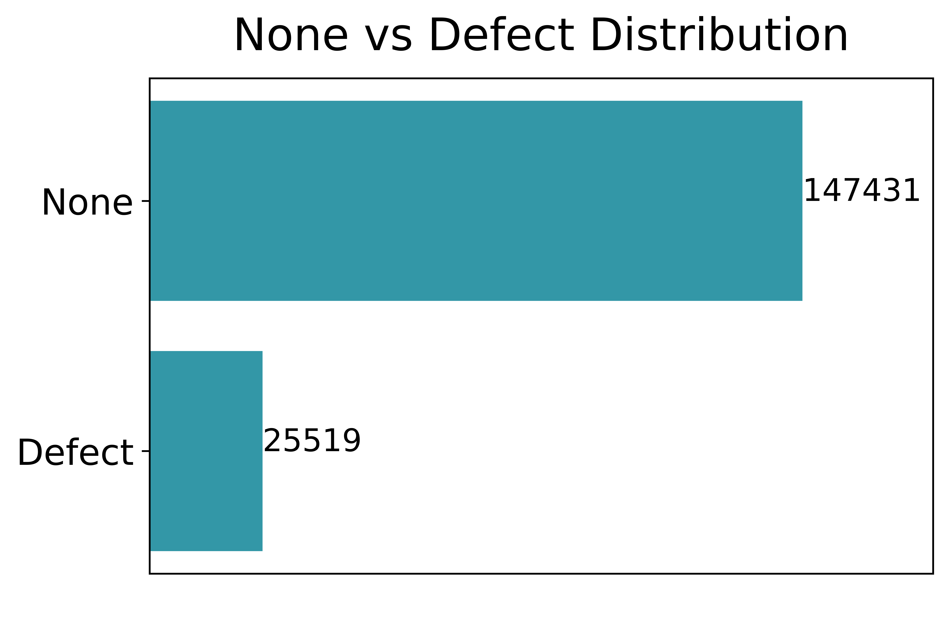
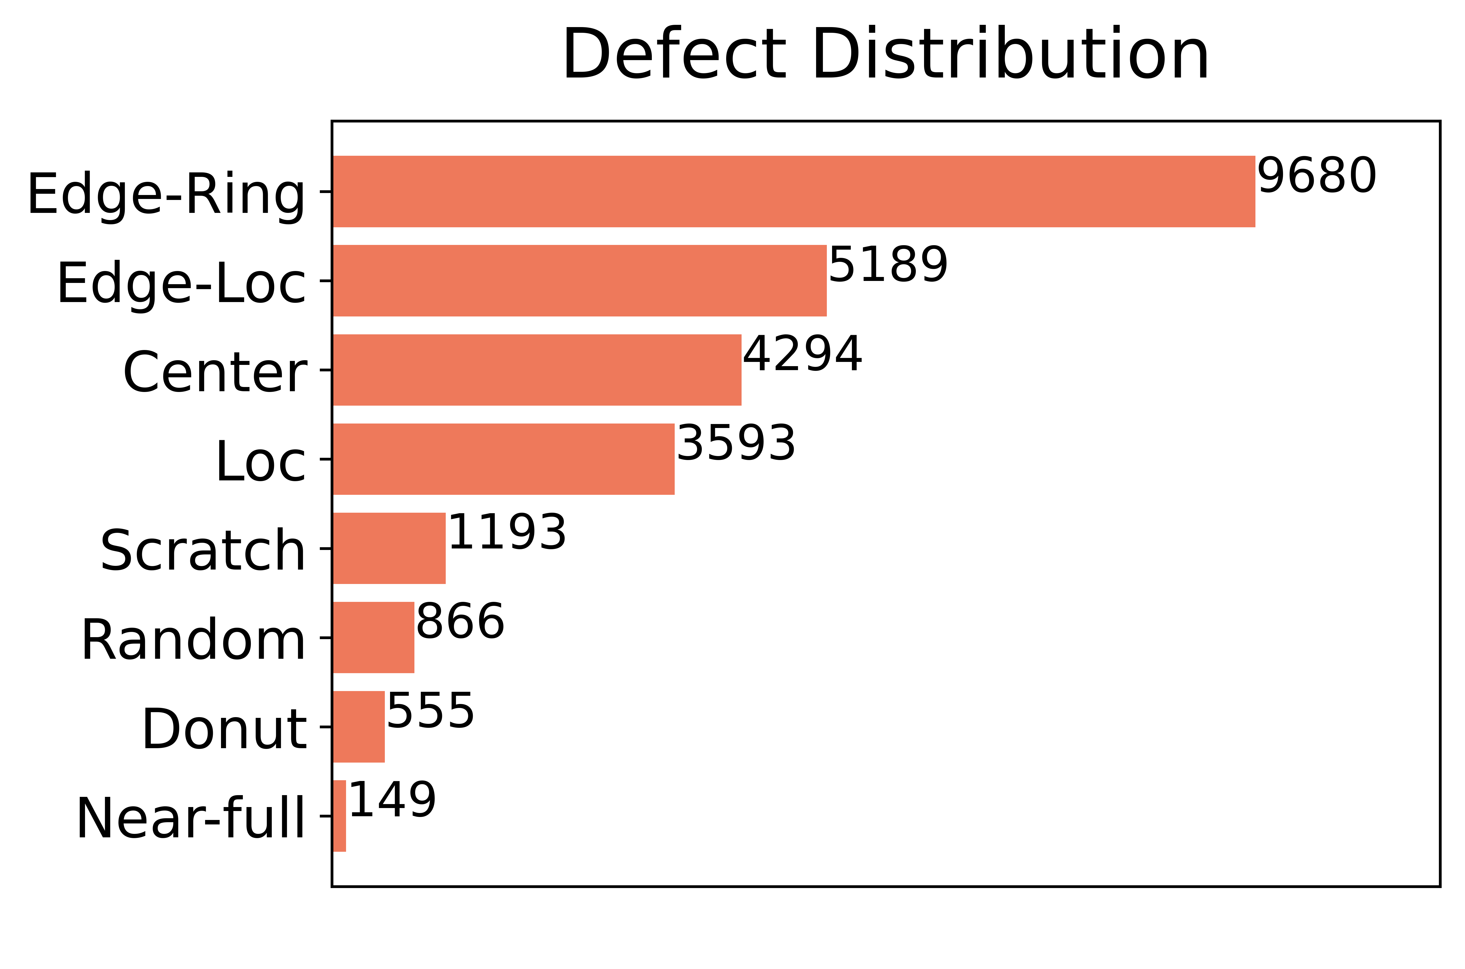
What does our data look like?
Doubly Imbalanced
Undersampling, data augmentation
Single-defect multi-class
9 classes total, including none
Variable quality and resolution
Resizing and pre-processing
Notes:
Main points:
Labeled data consist of single-defect wafers with 9 classes total (including none)
Click to show gray box
As in real-world, nones are most prevalent (~85%)
Data is doubly imbalanced because defect types are imbalanced as well
Click to show orange box
As in real-world, wafer map resolution varies (manufacturing plant can produce wafers for different applications with different die sizes)
In addition to variable resolution, the dataset also contains varying wafer quality (different amounts of “noise”)

Slide 8
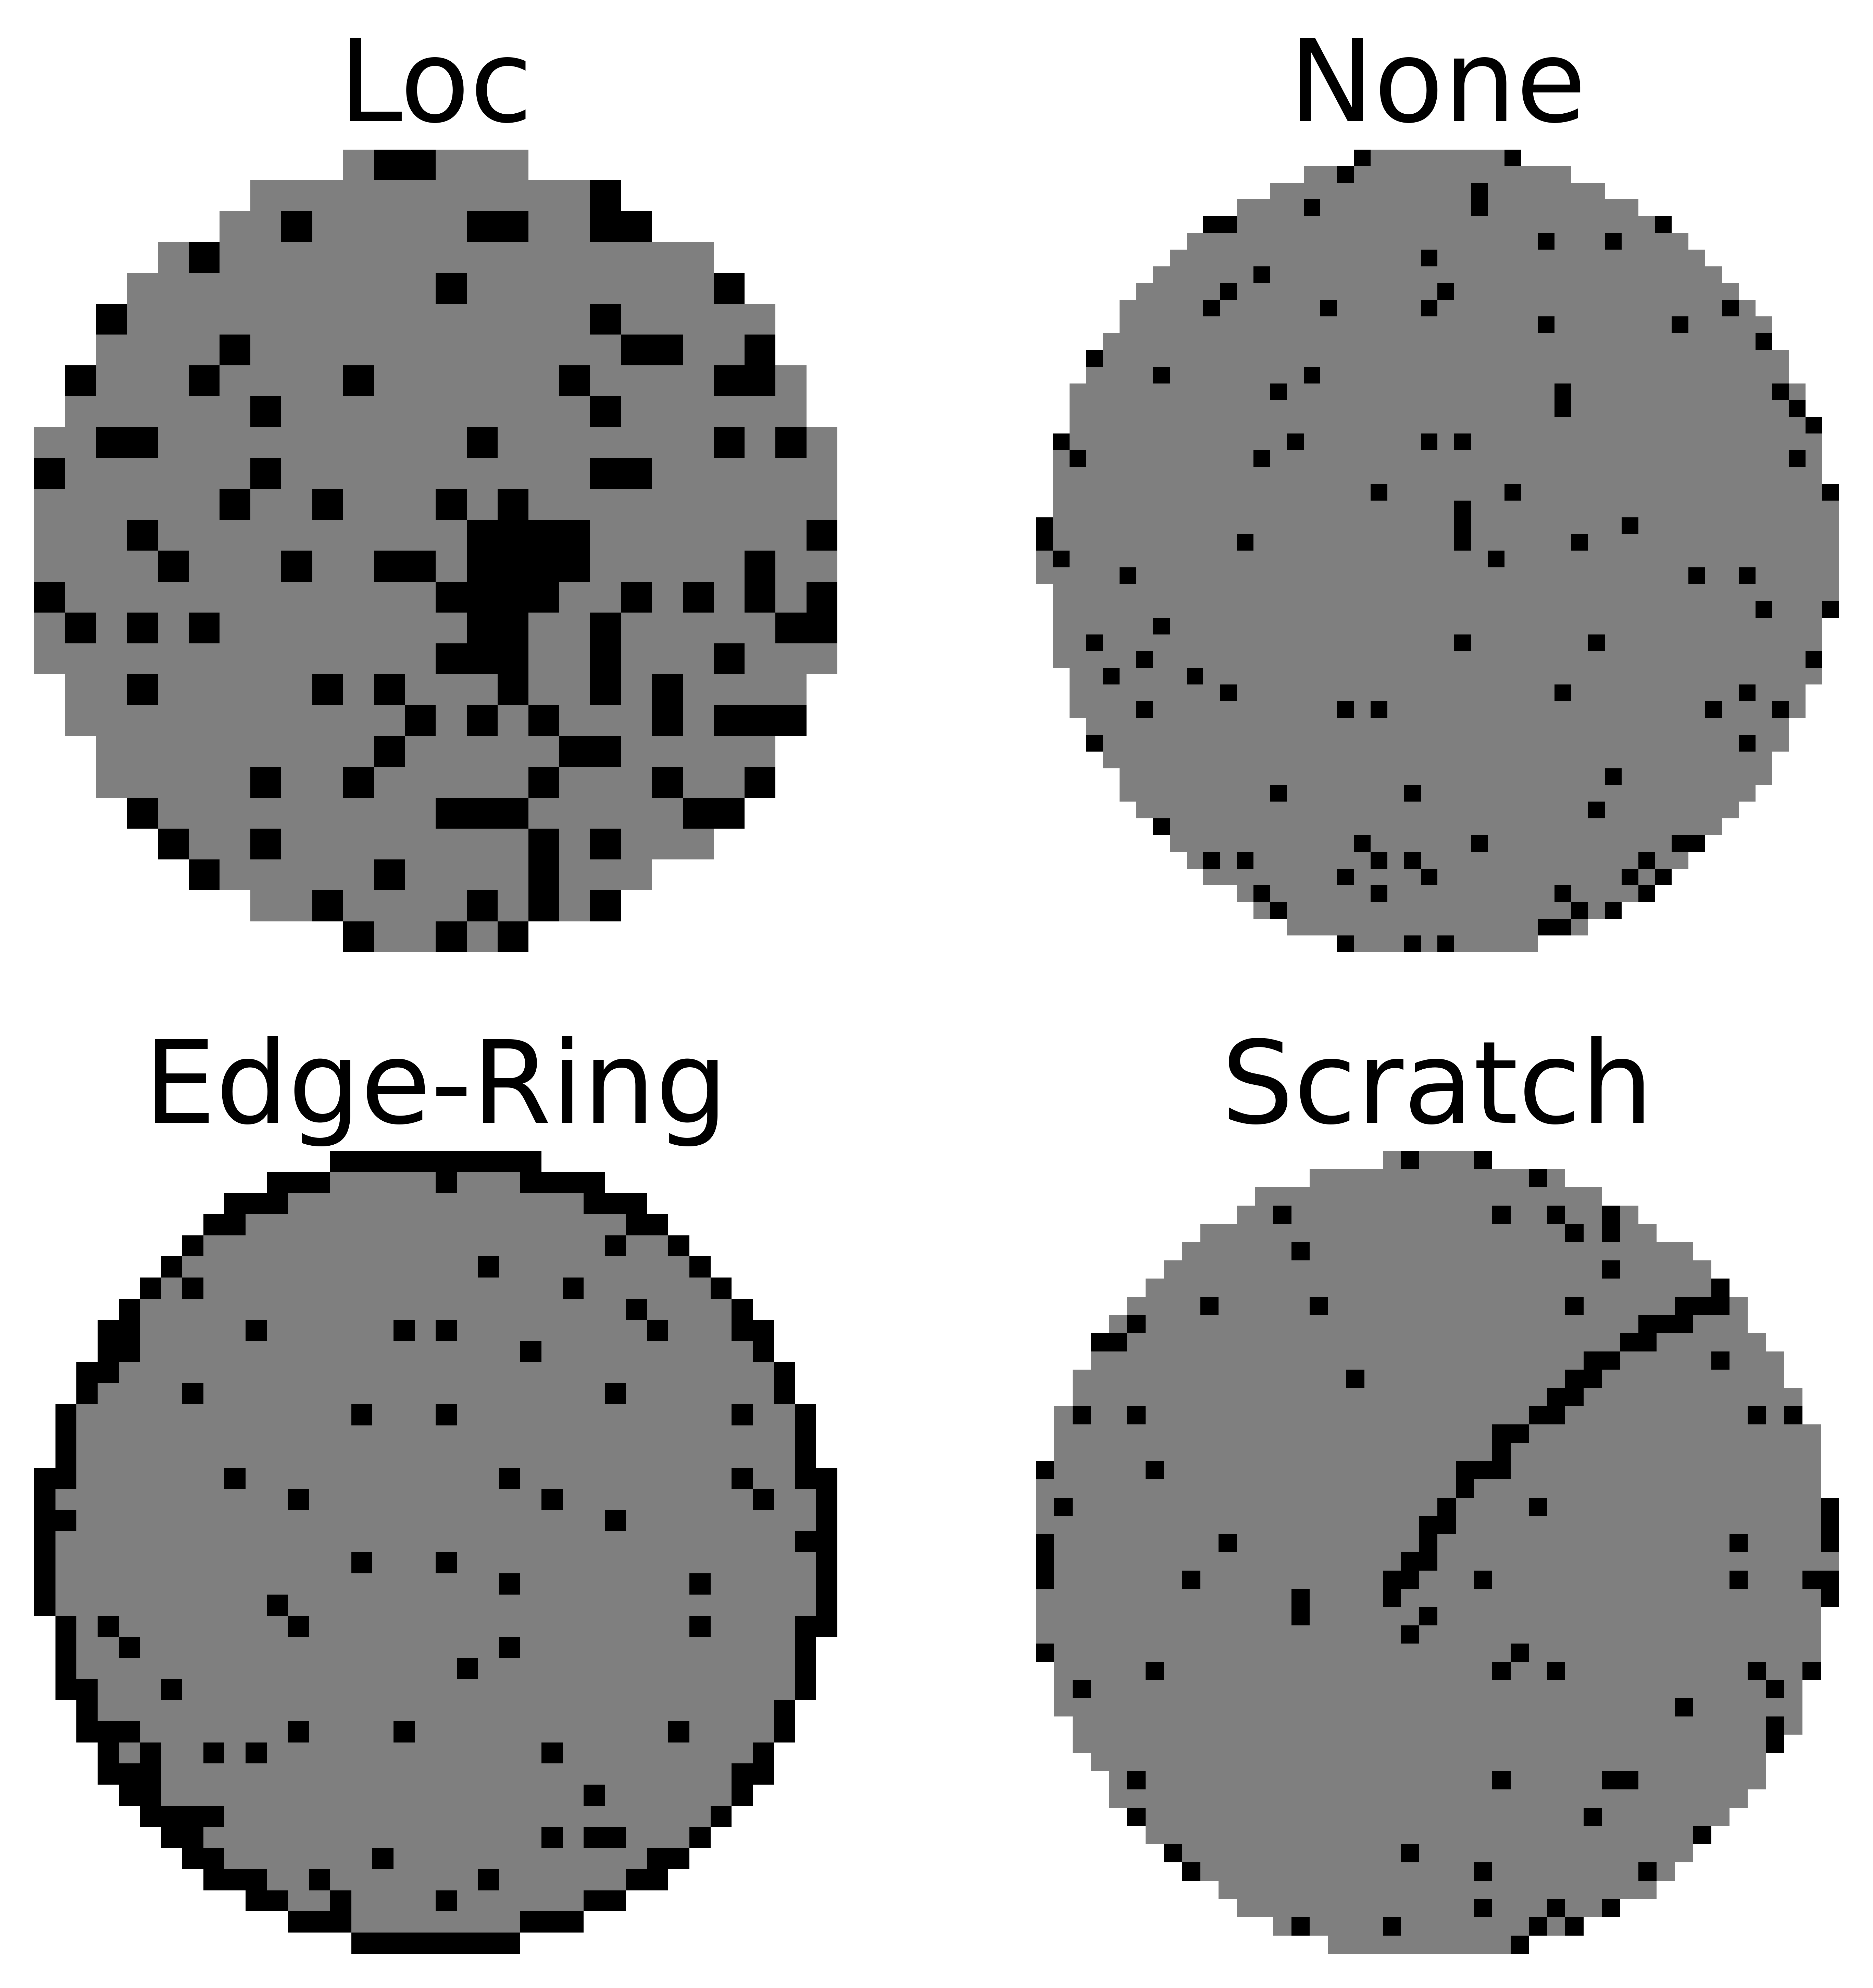
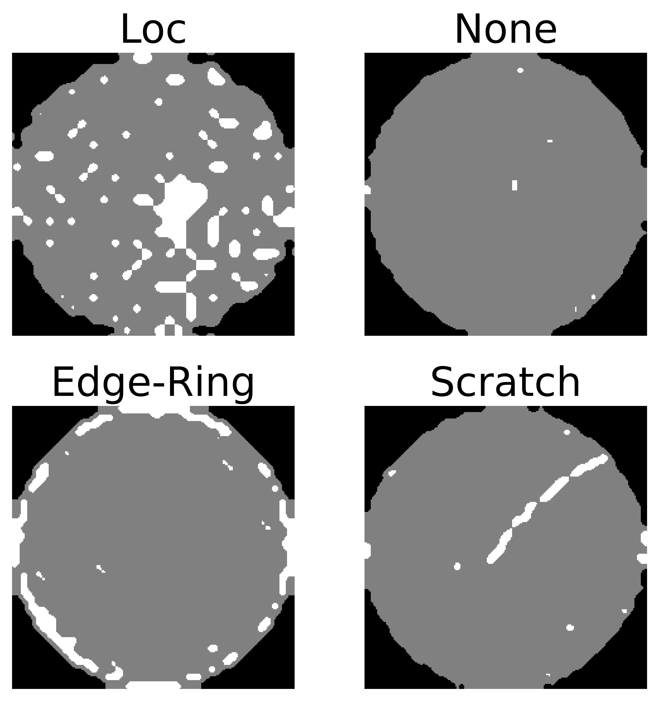
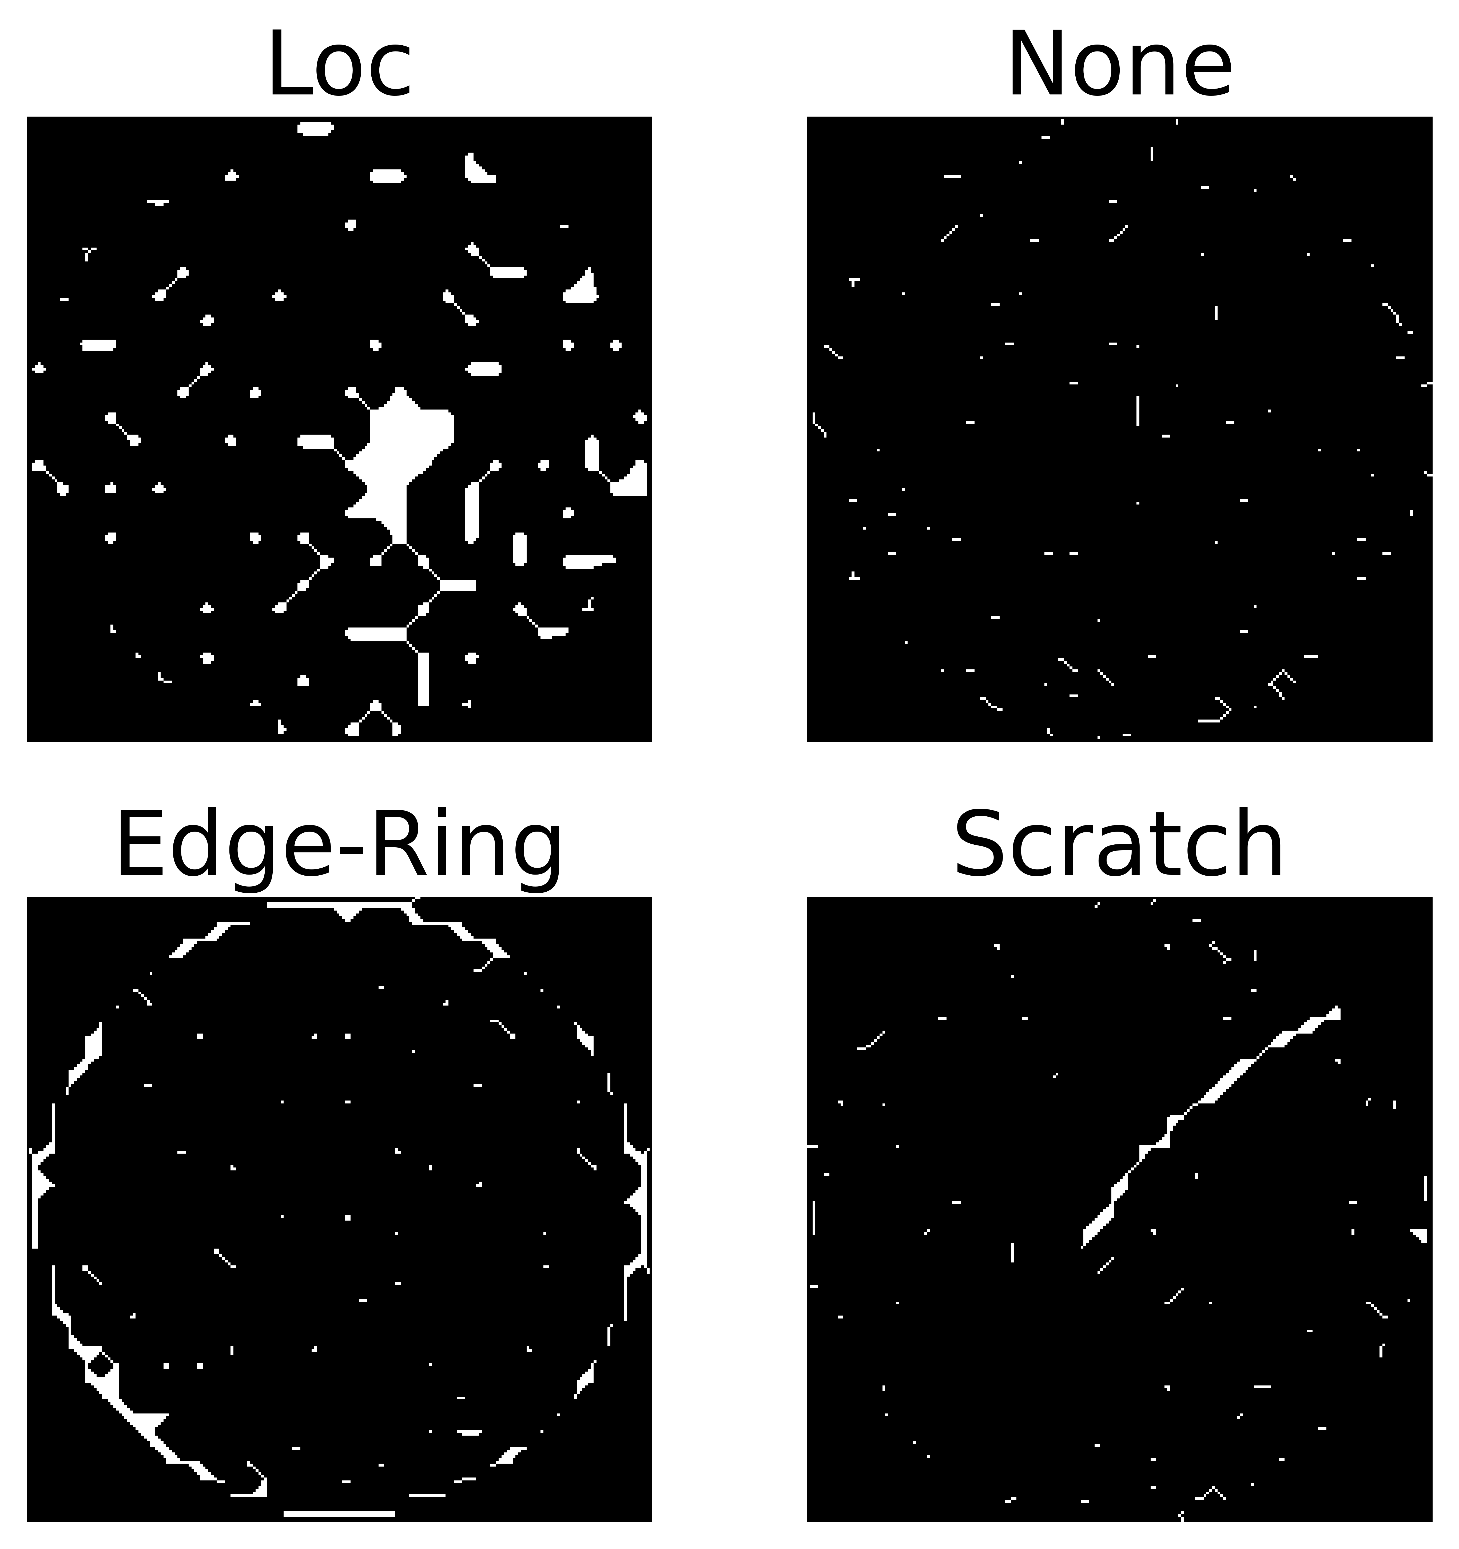
Which pre-processing performs best?
Performance on Tandem CNN model from Yu, et al paper
No pre-processing
96.63%
Median Filter (7x7)
97.11%
Morphological Thinning (n=2)
97.24%
Paper: https://ieeexplore.ieee.org/document/8815875
Notes:
In reality, all wafers will have a small amount of defective dies. This forms a salt and pepper background noise that our pre-processing step must mitigate. We need to remove as much of the background noise as possible while preserving any systematic defects on the wafers.
[Click to show median filter]
We first tried median filtering. The main idea here is to run through the signal entry by entry, replacing each entr4y with the median of neighboring entries. This method is widely used for removing salt and pepper noise while also preserving edges.
[Click to show morphological thinning]
Next we tried morphological thinning. This method is used to remove selected foreground pixels from binary images and is useful for skeletonization. We thought thinning could improve our model's performance in identifying slight scratches that can be washed out by median filtering.
We compared the performance of each type of pre-processing on one of our early models. Any pre-processing is better than none, but morphological thinning just edges out median filtering for the best performance.

Slide 9
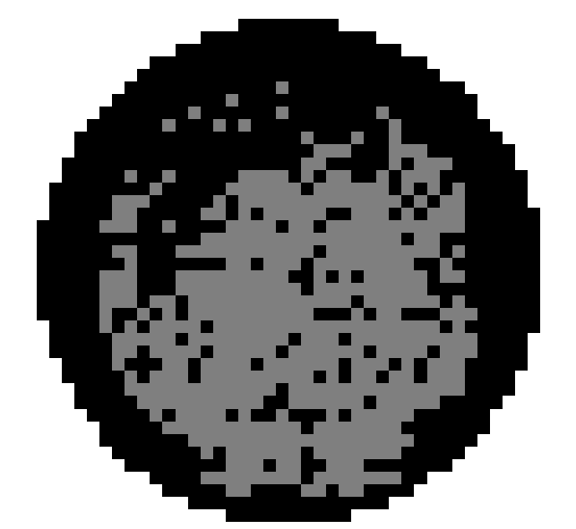
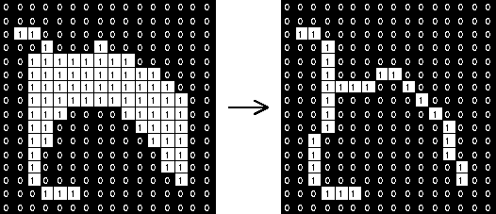
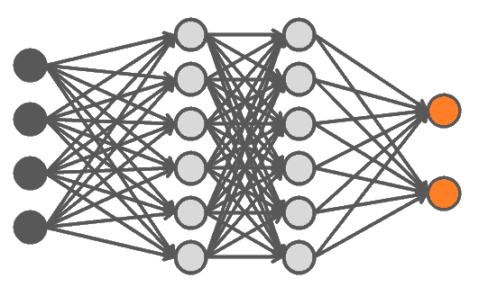

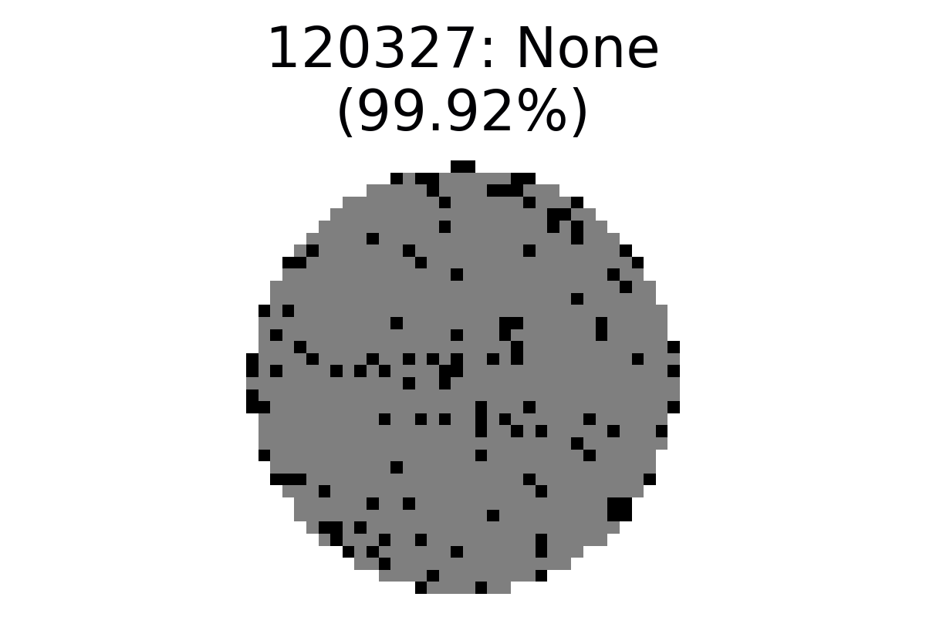
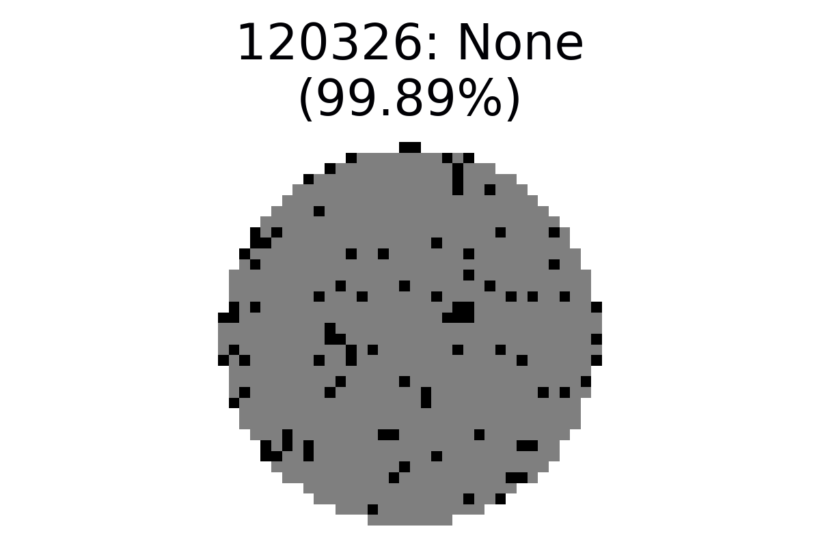
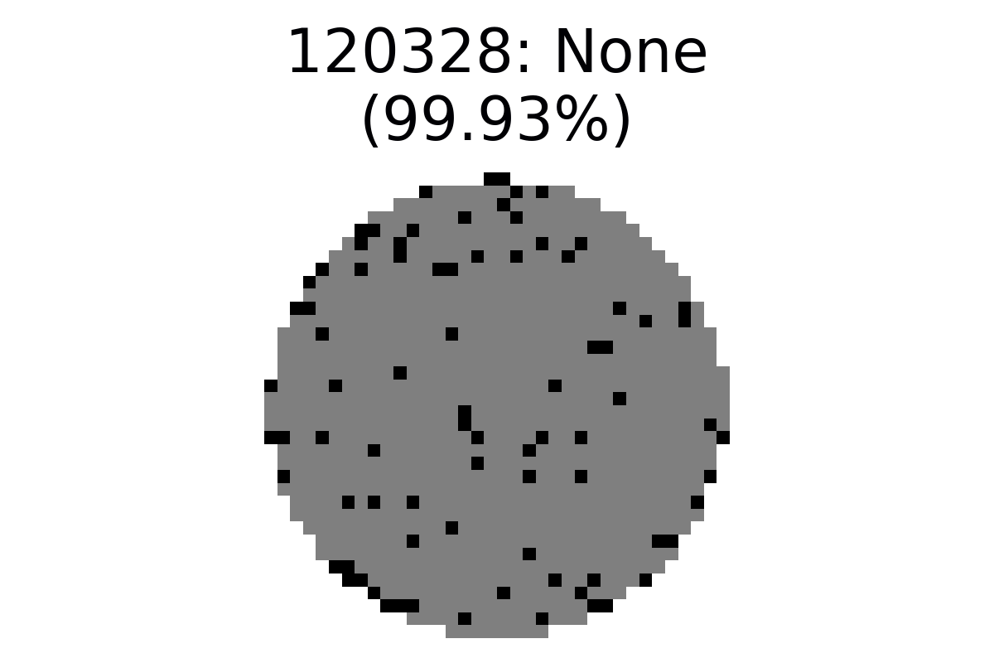
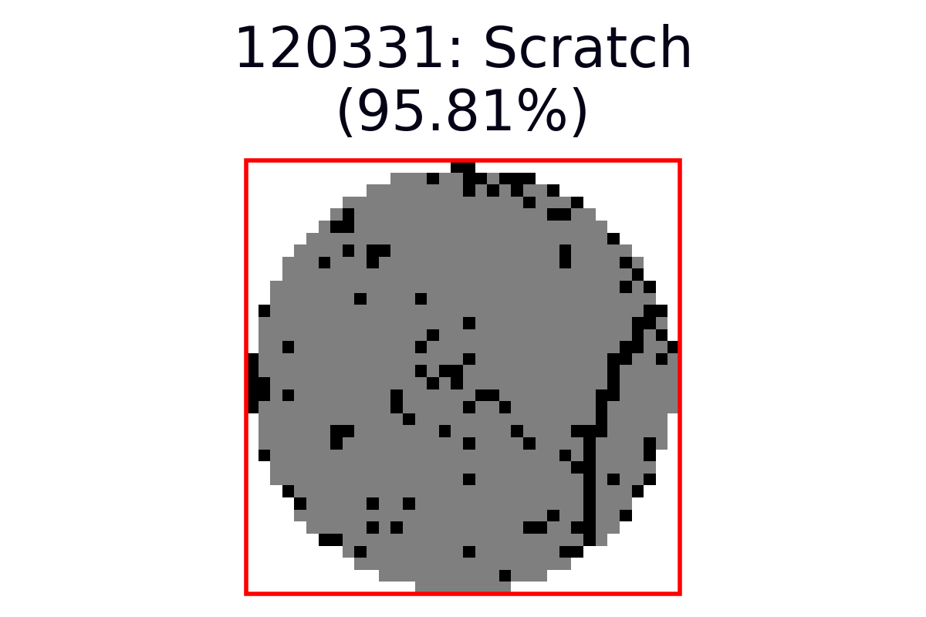
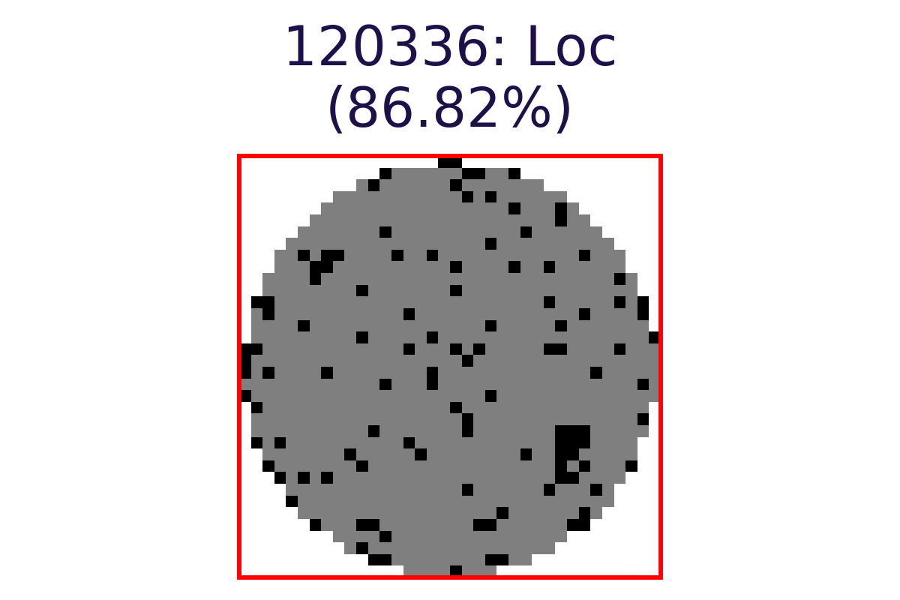
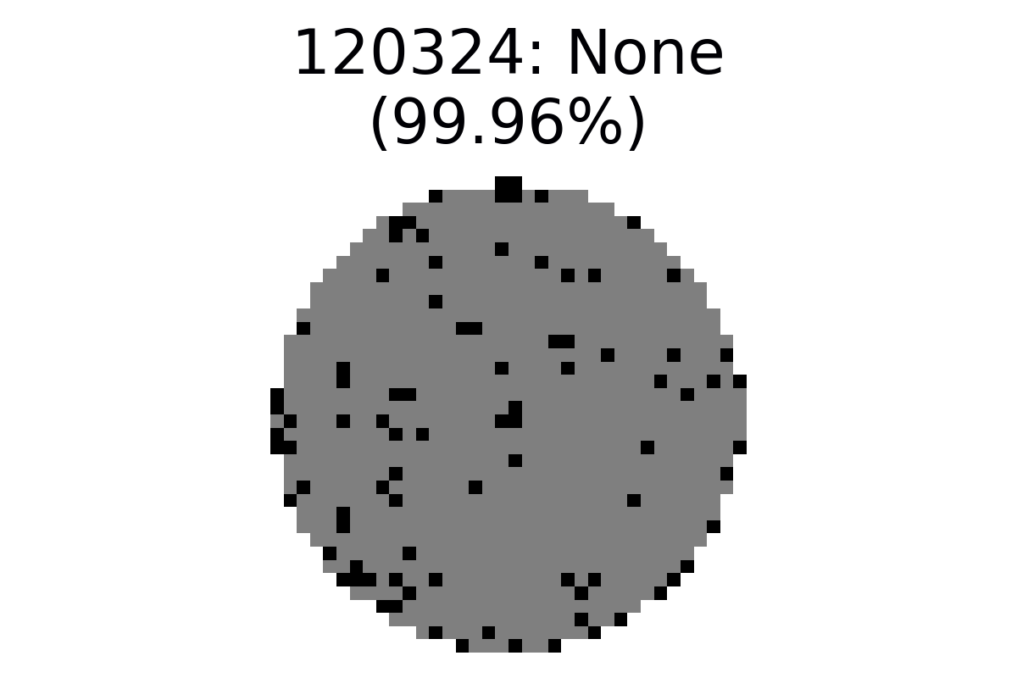
Model framework
Pass/Fail Wafer Maps
Image
Resizing
Morphological Thinning
Convolutional Neural Net
Wafer Classification
Notes:
Here is an overview of our model framework. First, we resize all the pass/fail wafermaps to 224x224. We then apply morphological thinning. For model training, we undersample the none type and introduce random flips and rotations to augment the defect types. Finally, we use a convolutional neural network to achieve the wafer classification.

Slide 10

Model architecture exploration
Architecture | Test Set Accuracy (%)
13-Layer CNN | 97.56
Tandem CNN | 97.24
Deformable CNN | 96.37
GoogLeNet | 97.32
ResNet (transfer) | 92.17
ViT L32 (transfer) | 94.44
Architecture | Test Set Accuracy (%) | MixedWM38 Accuracy (%)
13-Layer CNN | 97.56 | 76.02
Tandem CNN | 97.24 | 70.39
Deformable CNN | 96.37 | 57.40
GoogLeNet | 97.32 | 66.65
ResNet (transfer) | 92.17 | 52.24
ViT L32 (transfer) | 94.44 | 49.48
Architecture | Test Set Accuracy (%) | MixedWM38 Accuracy (%)
13-Layer CNN | 97.56 | 76.02
Tandem CNN | 97.24 | 70.39
Deformable CNN | 96.37 | 57.40
GoogLeNet | 97.32 | 66.65
ResNet (transfer) | 92.17 | 52.24
ViT L32 (transfer) | 94.44 | 49.48
Notes:
We tried various model architectures, from different flavors of CNNs to transfer learning with vision transformers. In our case, we found that simpler is better – the one-step 13 layer simple CNN outperformed all the model architectures we tried. In particular, transfer learning performed the worst. We hypothesize that this is may be due to the fact that the wafermaps are much lower resolution compared to actual images, such as those found in ImageNet datasets.
However, performance of the architectures we tried all exceeded our goal of 90% accuracy on the held-out test set from the WM-811K dataset.
[Click to show MixedWM38 results]
To see how well our model would generalize, we tested it on a second dataset. We did not use this dataset in training because it is mostly synthetic data generated from a GAN. It has an unrealistically balanced distribution between all the defect classes and is much more homogeneous within each class than the WM-811K dataset we used for training.
[Click to show final model highlight]
Testing with this second dataset provided better discrimination among our models and confirmed our choice of the 13 layer simple CNN. However, it was concerning that the results were much lower than our held-out test set, so we decided to try to understand our model a bit better through visualization and error analysis.

Slide 11

What does our model see?
Grad-CAM: Visualizes the class activation maps for the different defect classification types
Source: https://towardsdatascience.com/understand-your-algorithm-with-grad-cam-d3b62fce353
Notes:
Neural networks are often thought of as a "black box" but it doesn't have to be that way.
To understand what our model is seeing, we visualized the last convolutional layer before classification. Here we got confirmation that our model is working properly. It seems to be able to identify the defect patterns clearly.
Now that we know that our model is working as we expected, we want to understand why our model is making mistakes.

Slide 12
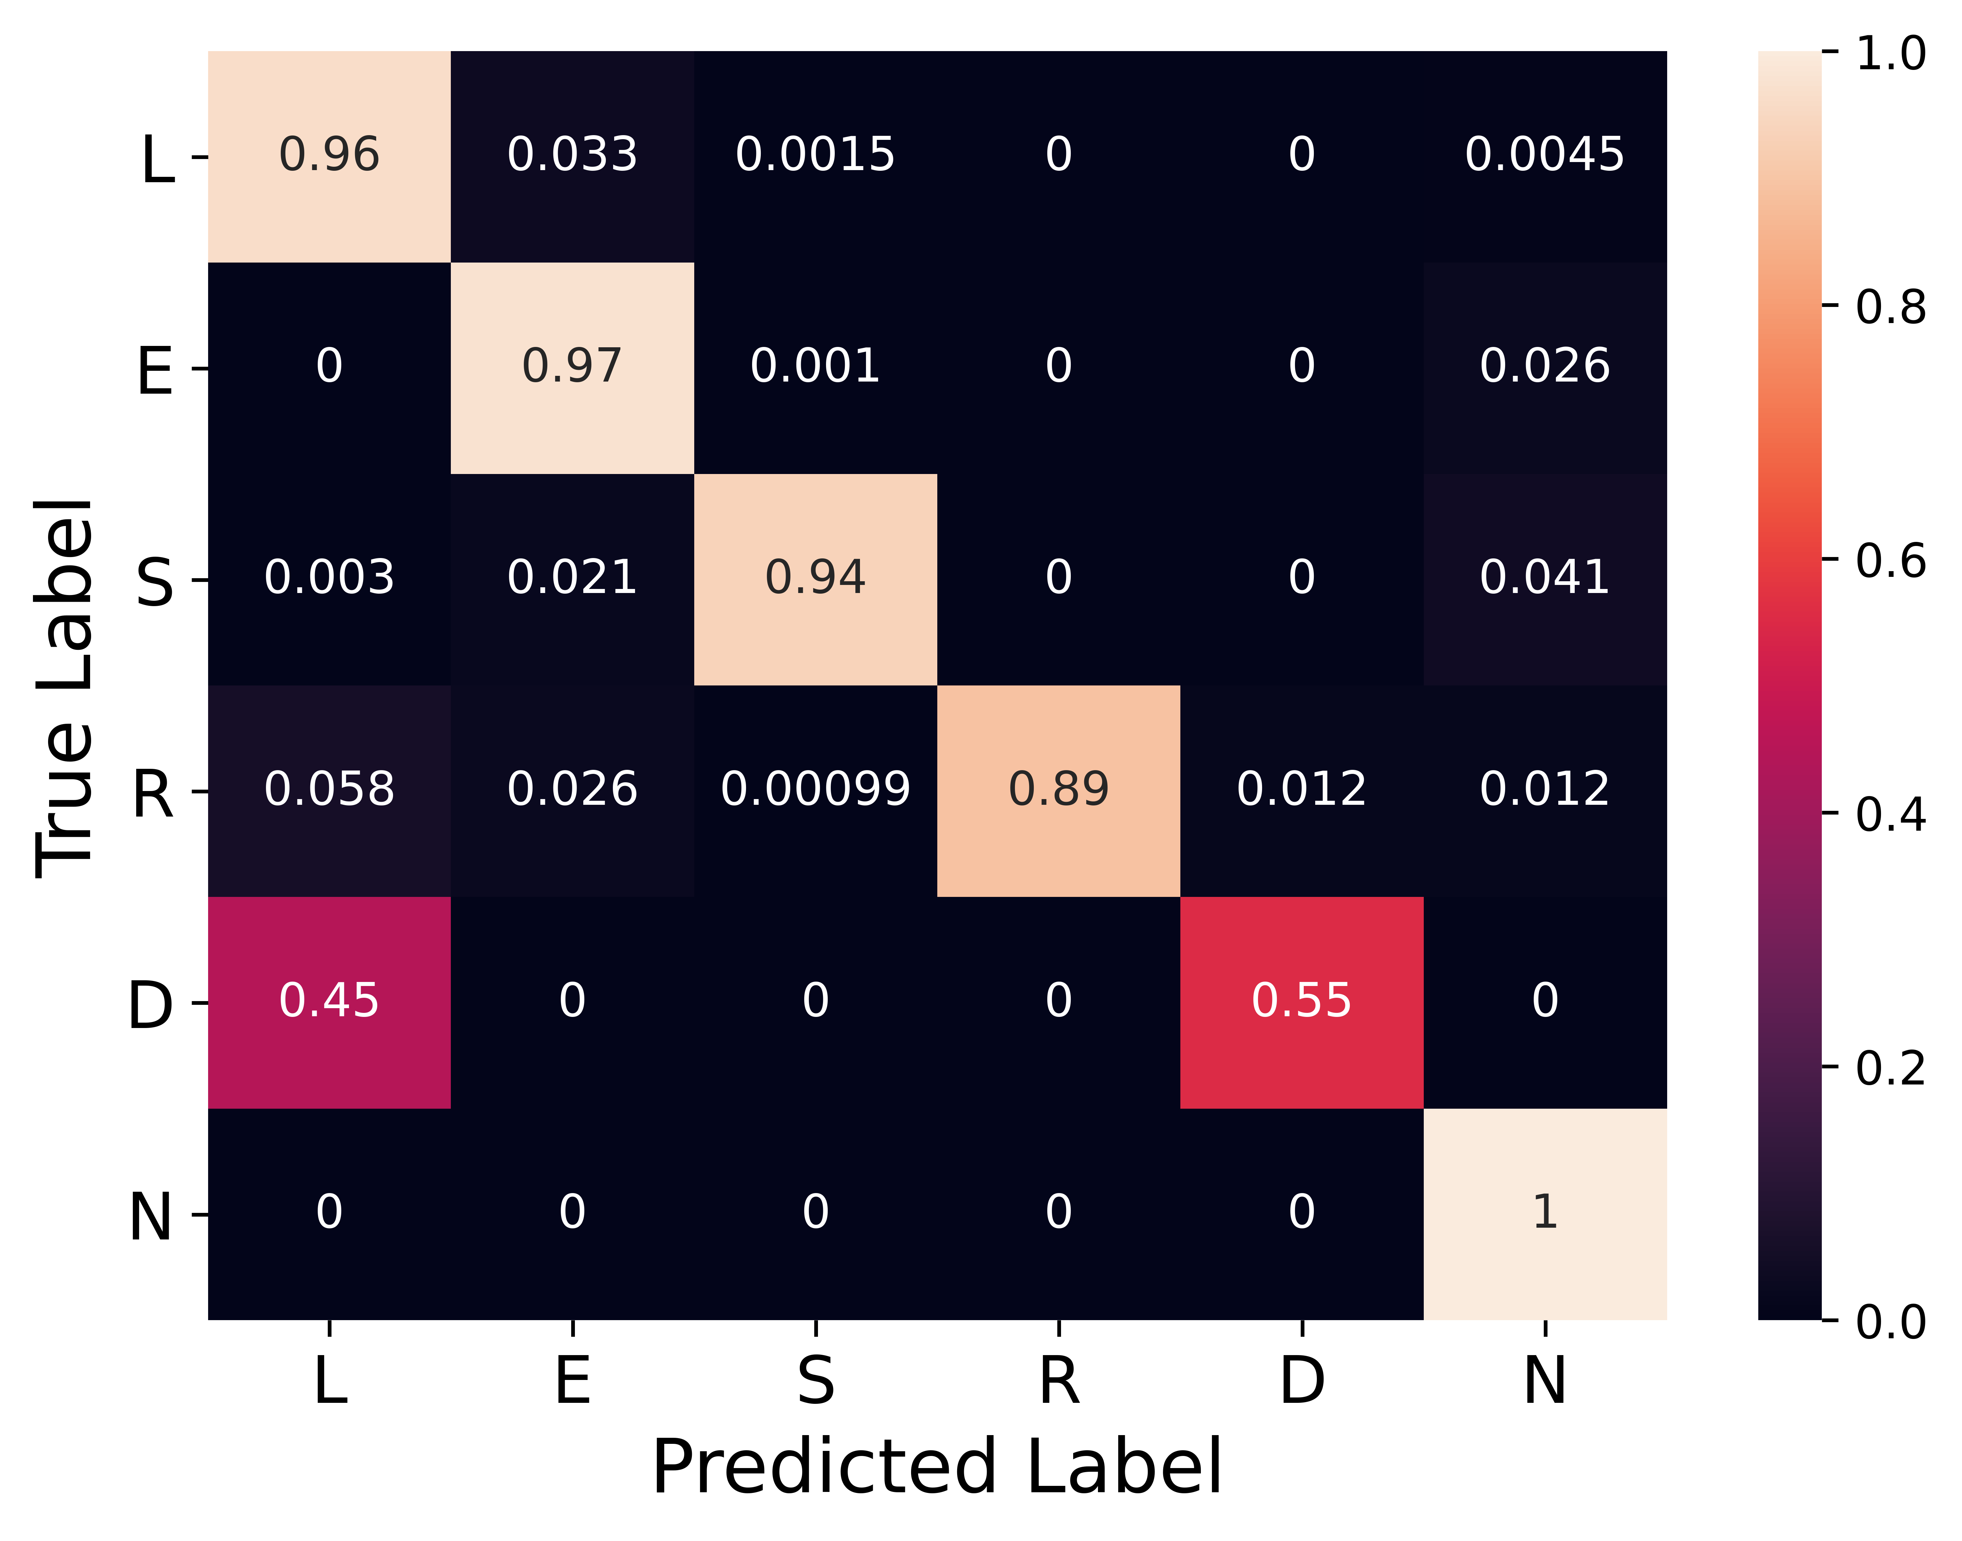
How well does our model generalize?
Most misclassified (MixedWM38 inference)
Recalculated Confusion Matrix
Edge-Loc + Edge-Ring,
Loc + Center,
Random + Near-full
Edge-
Ring
Loc
Random
Recalculated Accuracy = 90.62%
Notes:
Error analysis showed that our model is misclassifying three main classes: Edge-Locs are mistakenly labeled as Edge-Rings, Centers as Locs, and Near-fulls as Randoms. When we visualize examples of these mislabeled wafers, we can see how the model would make these errors. In fact, Edge-Locs and Edge-Rings have similar defect mechanisms, and the difference between Near-full and Random is just a threshold in the density of its defects.
Our model is getting tripped up by a systematic labeling issue.
[Click to show recalculation]
We recalculated our results to see how our model would have performed if these classes were combined. Now we get an accuracy that meets our goal of over 90%. This gives us confidence that our model is generalizable.

Slide 13
How did we fare with manual labeling?
Overall inference accuracy on manually labeled data = 53.31%
Manual labeling can introduce individual bias
Threshold for classifying a wafer as defective can vary
Notes:
After realizing how much labeling can impact the performance of our model, we decided to experiment with manual labeling. The WM-811K dataset included some unlabeled samples, so we wrote a script, took 15-30 minutes to each label about 600 wafers, and tested our model on this new dataset.
The results really highlight the value proposition of our model.
[Click to show model inference accuracy]
Overall accuracy of our model on the manually labeled data is 53%, but the breakdown by group member shows how subjective this task can be. Throughout this presentation, we have shown clear examples of defects, but in reality, many of the wafers are more ambiguous. Manual labeling can introduce individual bias, especially when the labelers are not trained or experienced. Using a model instead of manual labeling can make defect identification more consistent and efficient.
[Click to show wafers identified as defective]
Interestingly, our domain experts Naga and Scott performed at opposite ends of the spectrum. Both used their expertise to set different thresholds for classifying a wafer as defective. Scott optimized precision, while Naga optimized recall. Tunability is important, as business needs can change to favor one metric over another. Since it is easier to retrain a model vs human experts, using a model instead of manual labeling can enable a customizable solution in a more efficient timeline.

Slide 14

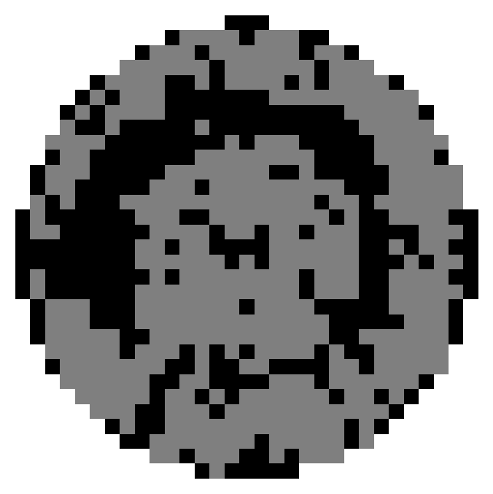


Production model pipeline
Customized data pipeline to meet the business need with real time inference
Data Collection
Ingestion
Pre-processing
Prediction
Presentation
Notes:
This is our production model data pipeline. It is completely customizable for the needs of the semiconductor manufacturer.
First, pass/fail data for all die (think of them as chips still in silicon form) on a wafer is collected on a fleet of tester and output into the ingestion pipeline. From here, our algorithm is able to quickly do the pre-processing steps of resizing and thinning. Next these wafermaps are sent to our model for predictions and those predictions are displayed in our web based solution. From here yield engineers can quickly identify yield issues. If there are any new defect types or incorrect classifications, those can be fed back to the model as additional training data for model improvement over time.

Slide 15

Notes:
Now, I’ll perform a demo of our tool. This is our website that has information about our project, the value proposition that we covered, more details about our model, a demonstration page and our contact info. Lets take a look at the demo.
So the first thing that comes up on the demo is simple aggregated information of the wafers and lots that have run in the last 24 hours. We can see that these are several wafers with no defect signatures and only a few hundred with signatures which is good. We can also see the lot distribution with stats on the number of wafers in a lot with that have defect signatures. Here we only have 2 lots with more than 20 wafers with signatures and several lots with no defects or less than 20 defects. This dashboard can easily be customizable for additional information the yield engineers would want to see.
In addition, there is drill down capability where you can select one of the lots that probed in the last 24 hours. This will bring up all the wafers in the lot and defective wafers are highlighted with a red box. You can see this wafer was correctly classified as a scratch with a high confidence in the prediction. You can also click on the non-defective wafers and get a high resolution image. Navigating back you can see the pareto of the wafer defect fail types. By clicking on a pareto item you will get all of the wafer maps for that defect time. This include the lot and wafer numbers and that data can be correlated with other fab information for root cause investigation. Again, the confidence in the classification is given.

Slide 16

Wafer Map Classifier for Early and Fast Defect Detection and Defect Source Identification
Consistent
Time Efficient
Customizable
Model can be tuned for custom Defect Patterns for fast defect sourcing
Cost Effective
Notes:
In summary, our Wafer Defect Classifier can aid in defect source identification and lead to improvements in yield for semiconductor manufactures. This leads to improved revenue and reduces cost. The model can be tuned and trained for any custom defect patterns that semiconductor manufacturers have. It is an efficient solution with consistent and accurate results.

Slide 17
Acknowledgements
Professors: Fred Nugen and Alberto Todeschini
TAs: Andy Reagan, Kevin Hartman, and Danie Theron
Peers: W210 Spring 2022 Section 6, special thanks to Seyfullah Oguz
Notes:
A special thanks to our Professors, Teaching Assistants and Peers for the feedback and very helpful input on our project.

Slide 18
Thanks for Watching
Any Questions?
Notes:
Thanks for listening and we welcome questions

